Slide 1
SQL Server 2008 24X7 Maintenance Considerations
Drew Flint
Plex Systems, Inc.

Slide 2
Database Maintenance
What is the purpose of database maintenance?
To ensure consistent, high performance of databases while protecting the integrity of the schema, end user data, and the SQL Server.

Slide 3
Database Maintenance
Physical Server
Disk Layout
Virtual Log Fragmentation
Wait Stats
Virtual File Stats
Consistency
Indexes
Statistics
Protection
Integrity Checks
Backups

Slide 4
Physical Server
Physical Disk Layout Considerations
How many spindles are enough to support the I/O workload?
How to distribute the data files onto a disk?
Selecting the correct block size.
Should you sector align the disk?

Slide 5
Physical Server
How many spindles are enough to support the I/O workload?
Ideally, you should be able to answer the following questions:
How many I/Os are going to the disk?
How long is it taking?

Slide 6
Physical Server
To answer the How Many I/Os question use disk performance counters from the last several weeks. I prefer to use the physical disk because that captures I/O information for all partitions on the drive.
Physical Disk
Disk Reads/Sec
Disk Writes/Sec
Disk Transfers/Sec

Slide 7
Physical Server
Once you have the I/Os you will also need to understand what type of RAID volume is hosting your data. The type of RAID will add additional I/Os.
RAID 1/10 – [Reads + (2*Writes)]/ # of Disks
RAID 5 – [Reads + (4*Writes)]/# of Disks
Generally speaking todays fiber channel SAS disks can support approximately 150 I/Os per second. Check the manufacturers specifications for exact details. We tune for 100 to 120 I/Os.

Slide 8
Physical Server
To answer the How Long question once again use the disk performance counters from the last several weeks. I prefer to use the physical disk because that captures I/O information for all partitions on the drive.
Physical Disk
Average Disk Sec/Reads
Average Disk Sec/Writes
Average Disk Sec/Transfers
Ideally all transfers to .mdf/.ndf files should be less than 10ms and all transfers to .ldf files should be 1 to 3ms.

Slide 9
Physical Server
Where to locate database files?
Microsoft’s best practices recommend separating the main data file from the log data file onto physically separate spindles.

Slide 10
Physical Server
What block size should the disk be formatted with?
The official answer is it depends on the type of workload running on the server. In general a 64K block size has been found to provide a consistently high level of throughput for the majority of workloads.
SQL Server scales the size of the read or write to the workload it’s processing. For example backups can be written in larger chunks than a log file write.

Slide 11
Physical Server
Should you sector align your disk?
Yes, you should. This will only increase your performance to the back end disk. There is some debate as to how much it will help.
Here is an article written by the SQLCAT team on alignment.
http://msdn.microsoft.com/en-us/library/dd758814(v=sql.100).aspx

Slide 12
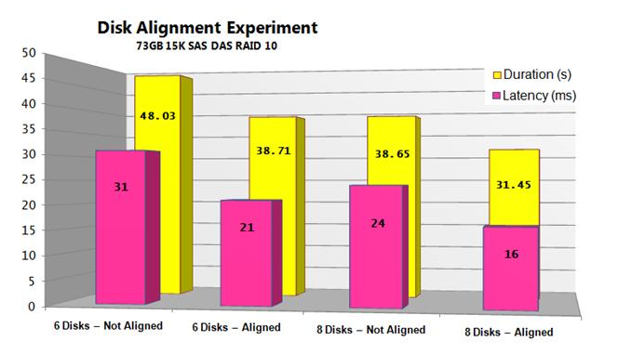
Physical Server
Here is a graph of performance improvement from Microsoft’s white paper:

Slide 13
Physical Server
As a contrast, on the next slide are some results from an experiment performed by Linchi Shea.

Slide 14
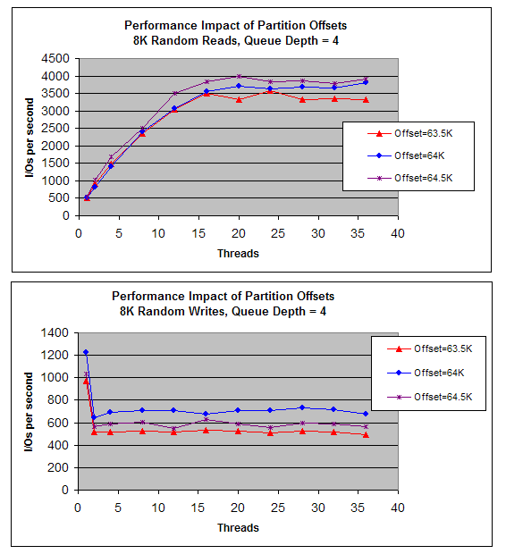

Slide 15
Physical Server
Be aware the impact of a configuration change varies with the type of workload.
MAINTENANCE FIRST PRINCIPLE
You should only make changes if you can show they make improvements in your environment.

Slide 16
Physical Server
Sector Alignment
Most likely, if you’re using Windows 2008 server OS or higher you are most likely sector aligned. The setting is configurable and can be controlled through the registry at:
HKLM\SYSTEM\CurrentControlSet\Services\VDS\Alignment

Slide 17
Physical Server
Sector Alignment
If you’re running on an OS earlier than 2008 your disk configuration isn’t aligned by default. If you’ve moved disks from an earlier OS to Windows 2008 they won’t automatically be fixed.

Slide 18
Physical Server
Sector Alignment
You’ll have to take different approaches to find out if your disk is sector aligned. If you have basic partitions then you can use the WMI console. If you have dynamic partitions, you need to use dmddiag.exe (Windows 2003) or diskdiag.exe (Windows 2008). If you have a basic, MBR partition you can use diskpart.

Slide 19
Physical Server
Sector Alignment
Basic MBR Partition Example
Commands
Diskpart
Select disk 0
List partition

Slide 20

Physical Server
Sector Alignment
Basic MBR Partition Example
Sample Output

Slide 21
Physical Server
Virtual Log Fragmentation
This can cause slowing of inserts, updates, and deletes. Further, it can cause your recovery times to skyrocket.
There is a case of a log file having 1.6 million fragments taking about 30 hours to complete recovery.

Slide 22
Physical Server
Virtual Log Fragmentation
Here is the breakdown on how the log file grows.
< 64MB = 4 VLFs
> = 64MB and < 1GB = 8 VLFs
> = 1GB = 16 VLFs

Slide 23
Physical Server
Virtual Log Fragmentation – Example growth scenario
Log file assumptions:
The base log file size is 1MB with a default file growth of 10%.
The first growth would be 102KB and contain 4 VLFs. The log file size would be 1.1MB.
The next file growth would be 110KB and contain 4 VLFs. The log file size would be 1.2MB.

Slide 24
Physical Server
Virtual Log Fragmentation – How many?
“It depends” is the answer. You will have to experiment to find the right number for your environment. Generally speaking you should strive for no more than 200.

Slide 25
Physical Server
Virtual Log Fragmentation – How do you find them?
You can use the DBCC Loginfo command. Each line returned represents a VLF.
Syntax Command
DBCC Loginfo(‘[DB Name]’)

Slide 26
Physical Server
Virtual Log Fragmentation – How do you fix it?
Backup the log file.
Shrink the log file to the smallest size possible.
Grow the log file to the right size for your environment in chunks. One big growth could be just as bad as too many small ones.

Slide 27
Physical Server
Wait Stats – What are they?
SQL Server’s method of letting us know what a given SQL Server instance is waiting on when trying to complete its workload.
This information is invaluable when trying to determine where best to invest your troubleshooting time.

Slide 28
Physical Server
Wait Stats – How do I see them?
They are stored in the SQL DMV called sys.dm_os_wait_stats.
A very basic syntax to retrieve what SQL Server is waiting on at that exact point in time is:
SELECT *
FROM sys.dm_os_wait_stats
ORDER BY wait_time_ms DESC

Slide 29
Physical Server
Wait Stats – How do I use them?
Wait stats are compiled from the time the SQL Server instance is started. In order to get meaningful point-in-time information, you will need to gather two point in time images and calculate the difference.

Slide 30
Physical Server
Wait Stats – How do I use them?
When wait stats are gathered over time they provide a starting point for continual improvement for your SQL Server.
The list of wait stats and what they are decoded as can be found in books online at:
http://msdn.microsoft.com/en-us/library/ms179984.aspx

Slide 31
Physical Server
Virtual File Stats
Virtual file stats measure I/O information perspective from SQL Server’s side. It details such information as how many reads, writes, how much data was read or written, and whether or not it encountered any stalls while completing them.

Slide 32
Physical Server
Virtual File Stats
Armed with this information, you can determine the latency, from SQL Server’s perspective, to access a given database file.
Using these, combined with perfmon physical disk counters, will enable you to know which files to separate when disk performance issues are encountered.

Slide 33
Physical Server
Virtual File Stats – Getting the 411
The data contained in this DMV is a point in time snapshot compiled from when the SQL Server instance is restarted.
The best way to get performance data over time is to take the delta between two point-in-time snapshots.
There are many samples of how to do this on the internet. Below is a link to T-SQL scripts for 2000, and 2005/2008.
http://www.sql-server-pro.com/virtual-file-stats.html

Slide 34
Physical Server
Virtual File Stats – Getting the 411
Here is a basic query
SELECT mf.name, vf.num_of_reads, vf.io_stall_read_ms, vf.io_stall_read_ms/vf.num_of_reads AS [read_latency_ms], vf.num_of_writes, vf.io_stall_write_ms, vf.io_stall_write_ms/vf.num_of_writes AS [write_latency_ms]
FROM sys.dm_io_virtual_file_stats (NULL,NULL) as vf
JOIN sys.master_files as mf
ON vf.database_id = mf.database_id AND
vf.[file_id] = mf.[file_id]

Slide 35
Physical Server
Virtual File Stats – Getting the 411
Here is some sample output
name | num_of_reads | io_stall_read_ms | read_latency_ms | num_of_writes | io_stall_write_ms | write_latency_ms
master | 49 | 620 | 12 | 77 | 628 | 8
mastlog | 10 | 42 | 4 | 115 | 948 | 8
tempdev | 26 | 266 | 10 | 34 | 106 | 3
templog | 8 | 6 | 0 | 69 | 358 | 5
modeldev | 61 | 465 | 7 | 4 | 5 | 1
modellog | 6 | 7 | 1 | 14 | 31 | 2
MSDBData | 164 | 1507 | 9 | 3499 | 23955 | 6
MSDBLog | 24 | 12 | 0 | 5265 | 9365 | 1

Slide 36
Consistency
These are maintenance tasks that help SQL Server keep performance at a predictably high level.
Index Maintenance
Statistics Maintenance

Slide 37
Consistency
Index Maintenance
We all know that indexes are a way to access data more efficiently. Over time normal use of the system will cause fragmentation in the indexes and makes them less efficient.
If we don’t maintain them, system performance will degrade.

Slide 38
Consistency
Index Maintenance
We also know that there are two approaches: ALTER INDEX REORGANIZE or REBUILD.
Let’s discuss the right time to use each one.

Slide 39
Consistency
Index Maintenance
The REORGANIZE option is a fully online process that offers a best effort optimization process. If a page is in use, it will be skipped by the optimization process. This means that after this process is complete, the index might still have some fragmentation.
There is some overhead incurred while this process is running but for the most part you can run it safely anytime.

Slide 40
Consistency
Index Maintenance
Something else to keep in mind when using the REORGANIZE option of ALTER INDEX is that the statistics for the index aren’t rebuilt. You will have to put your own process into place to maintain those.
The REORGANIZE process is partition aware so you can choose to maintain only the partitions necessary or the whole index.

Slide 41
Consistency
Index Maintenance
The REBUILD process is a process that removes all fragmentation possible from the index being maintained. This is an intrusive process for those of us not cool enough to have Enterprise Edition of SQL. The index will be inaccessible for the duration of time necessary for the index maintenance to complete.
However, if you do have Enterprise Edition, you can use the magical WITH ONLINE parameter.

Slide 42
Consistency
Index Maintenance
When using the WITH ONLINE parameter there is only a brief lock at the beginning and end of the maintenance process.
However, the WITH ONLINE parameter can only be used on the whole index not on an individual partition.
The REBUILD process can be focused to a single partition. The partition will be locked for the duration of the maintenance.

Slide 43
Consistency
Index Maintenance
The REBUILD process should be scheduled for periods of lower utilization as it is more intrusive.
The REBUILD process will also update the statistics for the index being maintained.

Slide 44
Consistency
Index Maintenance
Both types of index maintenance can cause log file growth.
Index maintenance can and should be automated. There is software for sale you can implement for this. It’s also straightforward to build your own. However, it will take much more time.

Slide 45
Consistency
Index Maintenance
Here are some key points to consider when building your own process:
Use the maintenance process to enforce your maintenance schedule.
How long the maintenance process can run.
What types of maintenance can run on which day.
Keep historical fragmentation information.
This allows you to measure the effectiveness of the maintenance process.

Slide 46
Consistency
Index Maintenance
Here are some key points to consider when building your own process:
The maintenance process is a living program. There are going to be changes that will have to be made over the lifecycle of the process.
If the analysis process starts to impact performance of the production server run the analysis on another server.

Slide 47
Consistency
Why are statistics important?
Statistics are used by the query optimizer to determine the most efficient method to update or retrieve data from a database.

Slide 48
Consistency
When are statistics created?
As part of the CREATE INDEX process.
When you manually create a statistic with the CREATE STATISTIC command.
If automatic creation/updating of statistics are enabled SQL Server can create single column statistics when the query optimizer determines they are needed.

Slide 49
Consistency
Find information about statistics
sys.stats – This has information about the statistic in general.
How it was created
Automatically vs. User
If it should be automatically updated
no_recompute = 0
Sample syntax:
select * from sys.stats

Slide 50
Consistency
Find information about statistics
sp_helpstats – This helps you know the columns (statistic_key) that make up a statistic (statistic_key). Statistics that begin _WA are created automatically by SQL Server.
Sample syntax:
exec sp_helpstats ‘customer’, ALL

Slide 51
Consistency
When are statistics updated?
Automatically when:
When the row count becomes > 0.
When the row count becomes > 500.
When the colmodctr has changed by more than 500 + 20% of the rows in the table.

Slide 52
Consistency
When are statistics updated?
Manually when:
UPDATE STATISTICS is executed
Used to manually update statistics for a single index or a whole table, depending on how it’s executed.
sp_updatestats
Automatically updates all statistics for all user defined and system tables.

Slide 53
Consistency
Statistic Tips
Leave Auto Create and Auto Update Statistics enabled. This will ensure the statistics are updated periodically.
Strategically change the sample size used by UPDATE STATISTICS. A larger sample size gives the query optimizer more accurate data to use when creating a new plan.

Slide 54
Consistency
Statistic Tips
Update statistics more frequently for ascending keys. This is because all new values lie outside the currently generated statistics.

Slide 55
Protection
These are things that database administrators should be doing to guarantee their databases survive problems.

Slide 56
Protection
There are two different major things database administrators should be thinking about:
Backups
Integrity Checks

Slide 57
Protection
Backups
We’re going to take a different approach to talking about backups. Instead of talking about what the different type of backups are and how you should mesh them together to form a complete backup plan, tonight we’re going to talk about what comes after the backup plan.

Slide 58
Protection
Backups
So what comes after the backup plan?
What, as administrators, are we obligated to do?
Test restoring the backups?
Managing your backup history?
Getting the backups off site?

Slide 59
Protection
Backups
Test restores
This operation is time consuming and takes a lot of disk space to complete.
In order to alleviate this burden there is a “lite” option that you can execute. It’s an option for the restore command called VERIFYONLY. It checks to make sure the backup set is complete and the entire backup is readable.

Slide 60
Protection
Backups
Backup History
The backup history table needs to be manually maintained. It’s added to every time a backup is completed.
The command is called sp_delete_backuphistory.

Slide 61
Protection
Backups
Offsite Backups
We need to constantly be thinking about how we can go further to protect our end user data. We need to consider the steps we need to take to protect our data should something happen to our primary facility.

Slide 62
Protection
Integrity Checks
These give us a point in time guarantee that the state of our database is good. It says as of this point in time everything about me is good. As with anything else you’re only as good as your last success.
Nirvana would be to continually run integrity checks. However, the overhead for running these checks will impact normal business operations.

Slide 63
Protection
Integrity Checks
How to execute them?
An integrity check can be performed by executing the following command:
DBCC CHECKDB ( Database Name, Options)

Slide 64
Protection
Integrity Checks
What does it do?
An integrity check verifies the following information about the database being checked:
DBCC CHECKALLOC (Disk space allocation)
DBCC CHECKTABLE (On every table)
DBCC CHECKCATALOG (Verifies MetaData)

Slide 65
Protection
Integrity Checks
Operational tricks
Run the checks on another server with recently restored backups. Obviously, you need to have the disk space to do this.
If you don’t have disk space but have a SAN try taking a snapshot and attaching it to another server to facilitate the integrity checks. This does create some overhead on the source volume and might impact normal business operations.

Slide 66
Protection
Integrity Checks
Operational tricks
If you only have a very limited amount of time to run your checks, you can use the option WITH PHYSICAL_ONLY. This only checks the integrity of the physical structure of the page and record headers. It doesn’t perform any logical checking.

Slide 67
Protection
Integrity Checks
Operational tricks
Another option that may reduce execution time is NOINDEX. This tells the DBCC engine to not check the non-clustered indexes.

Slide 68
Protection
Integrity Checks
Operational tricks
Run a combination of checks if you can’t consistently run a full DBCC check.
The idea is it’s better to be checking something than to miss something potentially career altering like data corruption.

Slide 69
Technical Credits
Statistics used by the Query Optimizer in Microsoft SQL Server 2008. By: Lubor Kollar, February 2009.
SQL Server 2008 Internals. By: Kalen Delaney
SQL Skills web site: www.sqlskills.com
SQLCAT Team web site: www.sqlcat.com
Linchi Shea’s Blog: http://sqlblog.com/blogs/linchi_shea/default.aspx

